Slide 1

Crypto Trading Bot with Multi-Strategy Live Deployment
By Benjamin Lee

Slide 2
Table of contents
01
02
03
04
Introduction, Motivations, Objectives
Work done, Improvisations made, Features of FYP Bot
Outcome & Results, Limitations
Conclusion and Future Works

Slide 3

Motivations
Operating Hours
2. Manual Trading is emotion-driven
Traditional Stock Market (US) | Cryptocurrency Market
2130 to 0400 | 24/7
3. Lack of real-time signals in manual trading
Manual traders have to go online and spend much time reading and understanding the market sentiment.
prone to panic selling
FOMO

Slide 4
Competitive Gap
Features | Competitors such as 3Commas, Pionex, etc | FYP Crypto Trading Bot
Pricing | Mostly Tiered Pricing Systems: Ranging from 0 to over $2000 USD | Free
Trading Strategies | Mostly Fixed, Unless Subscription | Able to customise trading strategies
Backtesting | Basic performance stats | Full trade logs, win rate and ROI comparison
Strategy Per Coin | Same logic applies to all coin | Tailored Strategy for each Coin
Market Context Awareness | Lacks Macro Awareness | Whale Alerts and Sentiment Analysis
Deployment Approach | Local desktop or VPS only | Dockerized and Deployed on AWS EC2 for 24/7 runtime

Slide 5




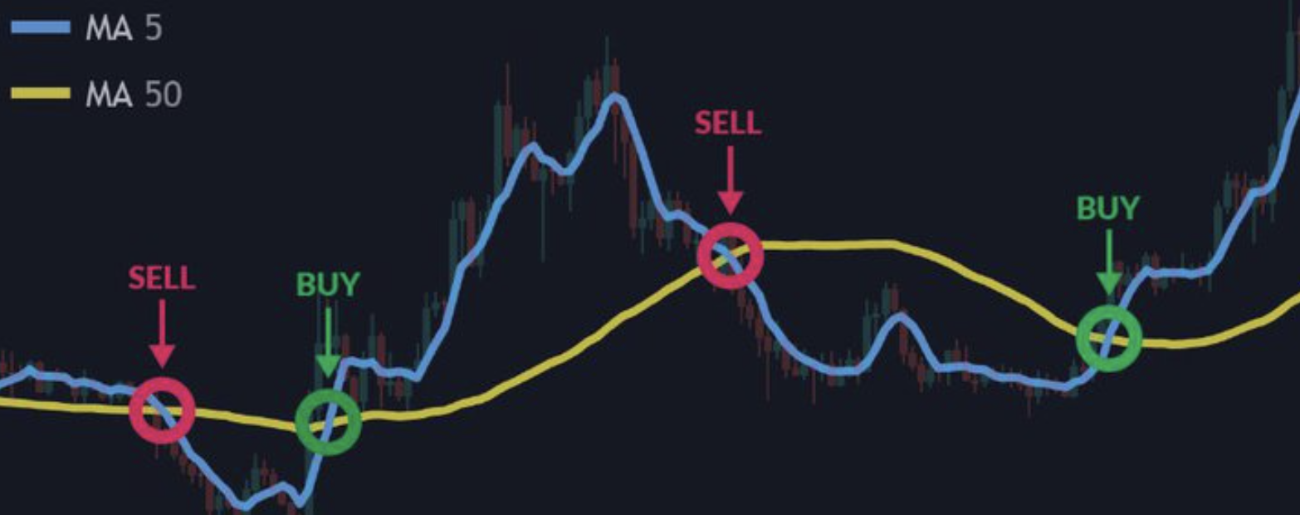

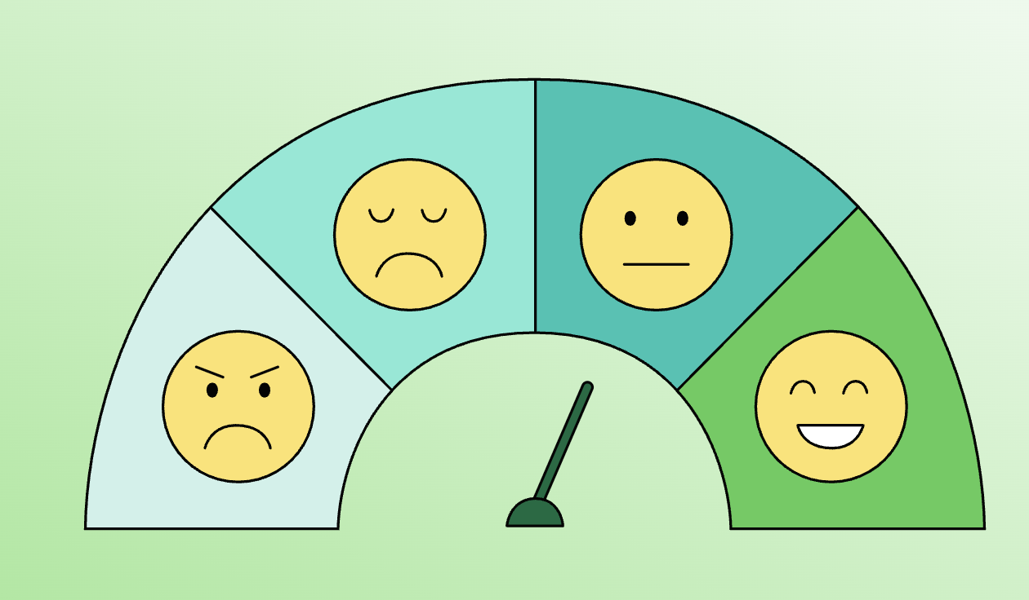
Objectives for the Crypto Trading System
Capable of trading multiple coins
Use technical indicators for execution
Able to Monitor and Track Performance of each individual trading bot
Incorporate whale alerts and sentiment analysis to retrieve market shift signals

Slide 6
High-Level Component Diagram
Backtests
Binance API
reddit (PRAW) API
X.com API
Python Libraries
Market Analysis Webapp
Flask
Javascript
CSS
Html
strategies.py
Cloud Deployment
Docker
AWS EC2
Docker to ensure compatibility of environments
strategies.py
Crypto Trading Bot
Whale Alerts
telegram API
WhaleAlert.io API
Live Paper Trading
Binance API
Python Libraries
Telegram API
Whale Alerts for transactions above 1,000,000
Sentiment Analysis
Textblob
reddit (PRAW) API
day, week, month
sentiment score
for selected coin

Slide 7
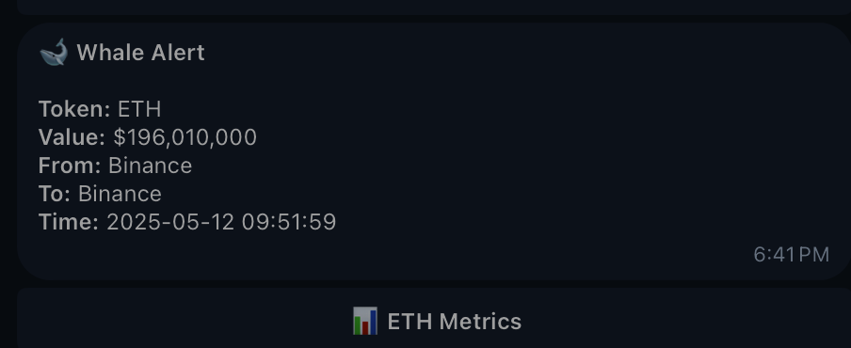
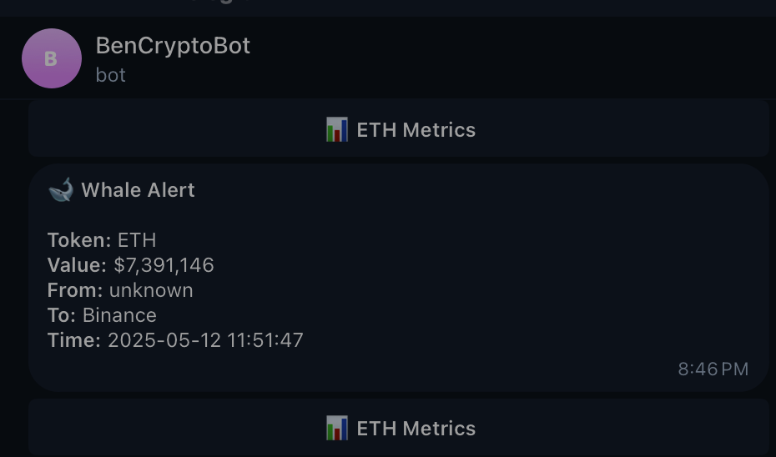
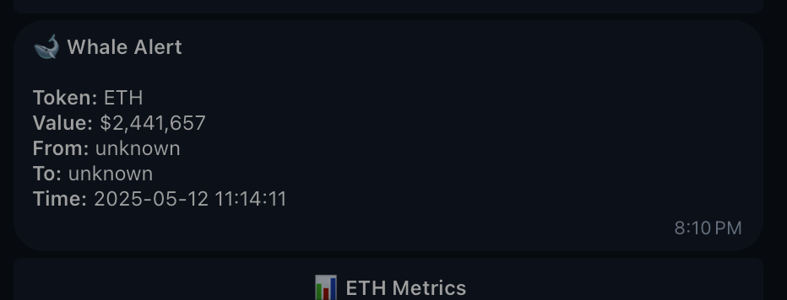
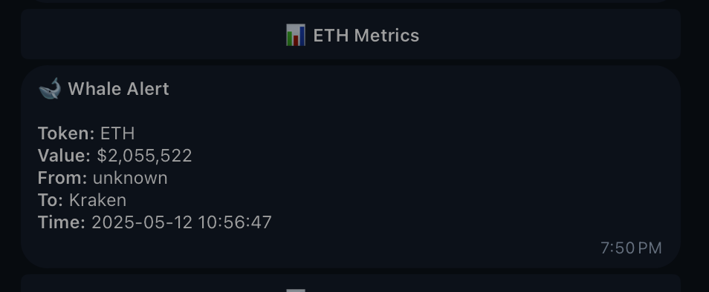
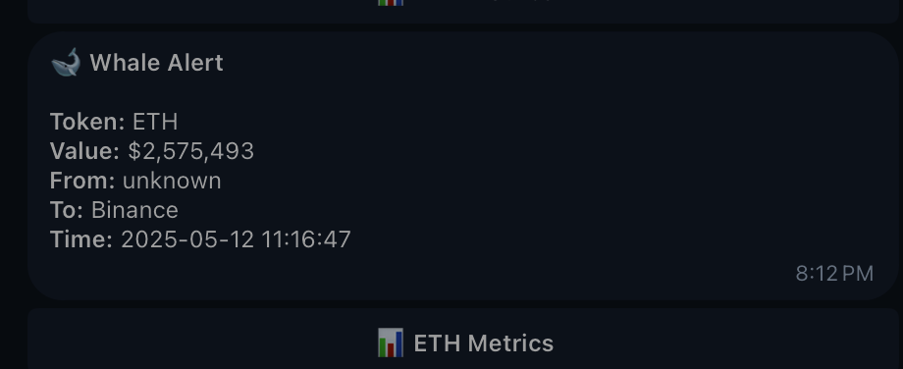
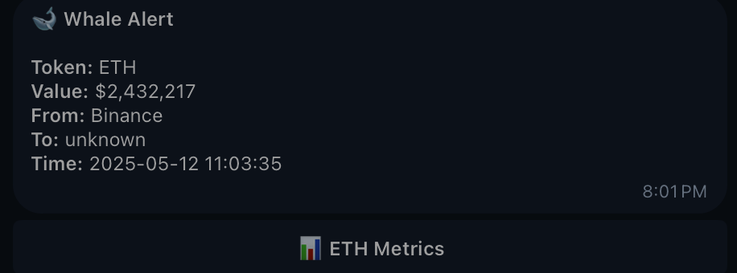
Whale Alerts

Slide 8
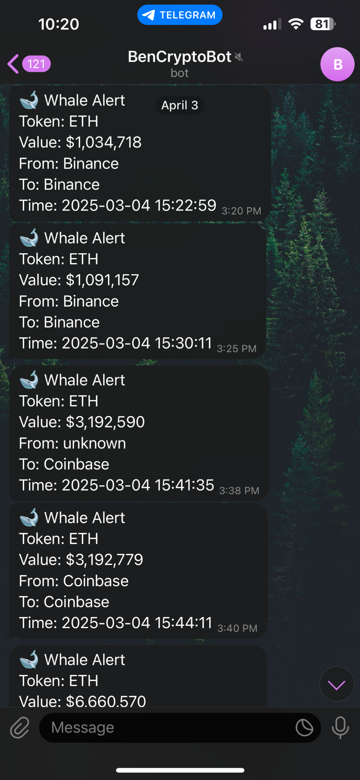
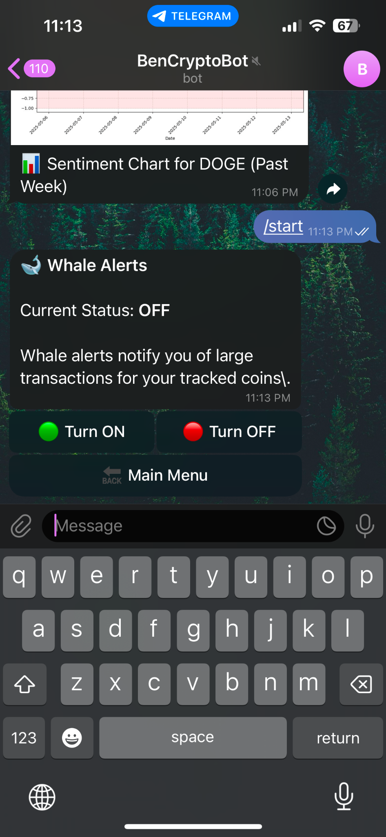
Whale Alerts
Tracks transactions over 1 million dollars using WhaleAlert.io API
Alerts are sent through Telegram API
Alerts can be switched ON/OFF
Useful to catch market shifts

Slide 9

Sentiment Analysis
Backtested Buy/Sells with Sentiment Analysis Scores using TextBlob for DOGECoin during 2021-05-25 to 2021-09-14
Key Context
April–early May 2021: DOGE peaked largely due to Elon Musk’s tweets and hype leading up to his SNL appearance on May 8, 2021.
May 9 onwards: Market began dumping. From mid-May to September 2021, sentiment dropped sharply and DOGE declined from ~$0.70 to ~$0.20.
Initially, I theorised that trading based on sentiment would be profitable since dogecoin is a largely sentiment-driven coin

Slide 10
Sentiment Analysis Backtested Result (DOGECOIN)
Metric | Value
Period | 2021-05-25 to 2021-09-14
Initial Cash | $10,000.00
Final Value | $5,904.64
Total Return | –$4,095.36
Total Trades | 1,181
└── Buys | 591
└── Sells | 590
Avg Sentiment at Buy | 56.23
Avg Sentiment at Sell | –34.04
Min Tweet Count Threshold | 100
Positive Sentiment Threshold | 0.3
Negative Sentiment Threshold | –0.3
This result matches other studies(e.g B.D.P. See & M. Ulpah) that shows that there are no significant correlation between sentiments and price movements.

Slide 11
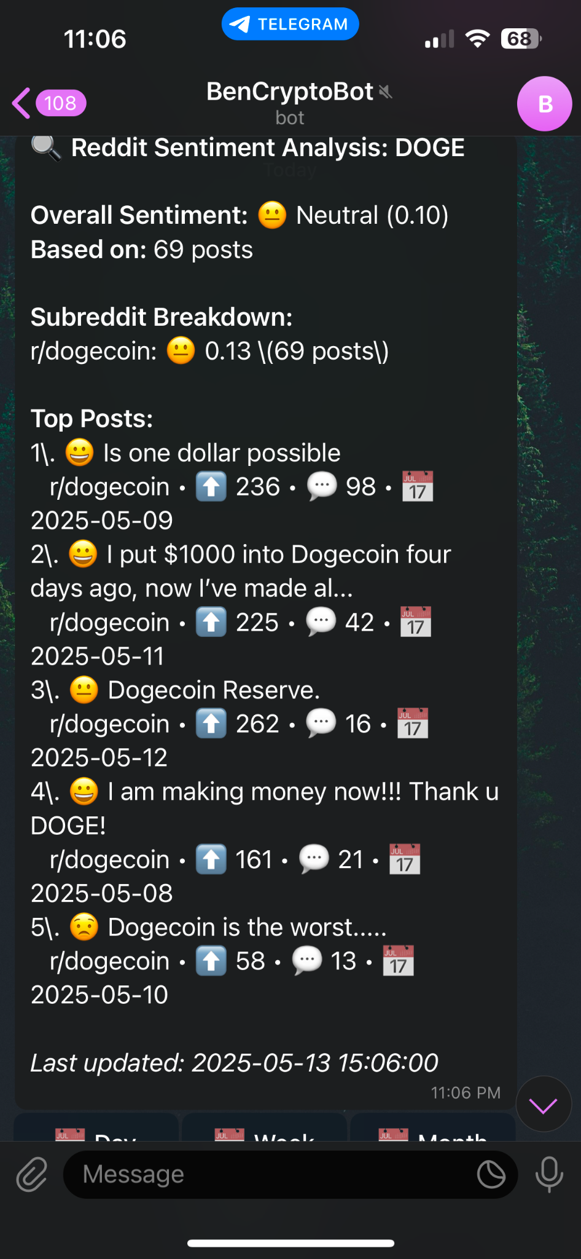
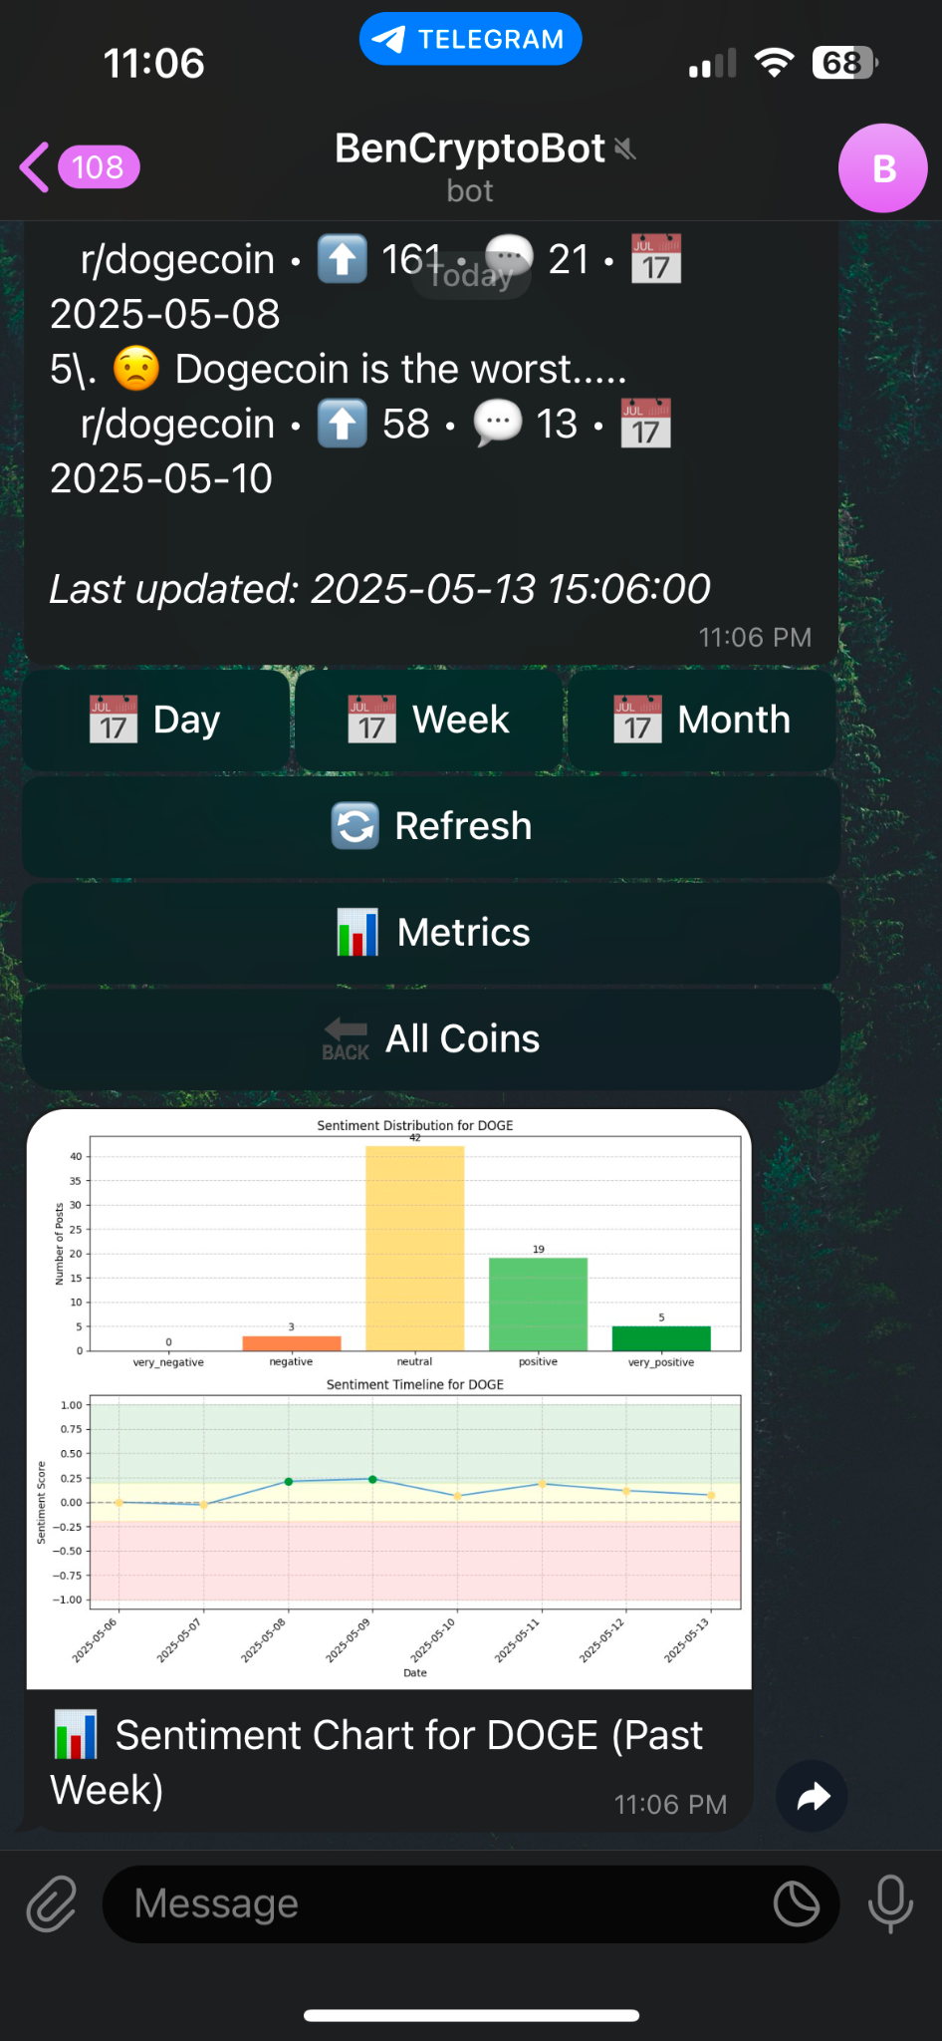
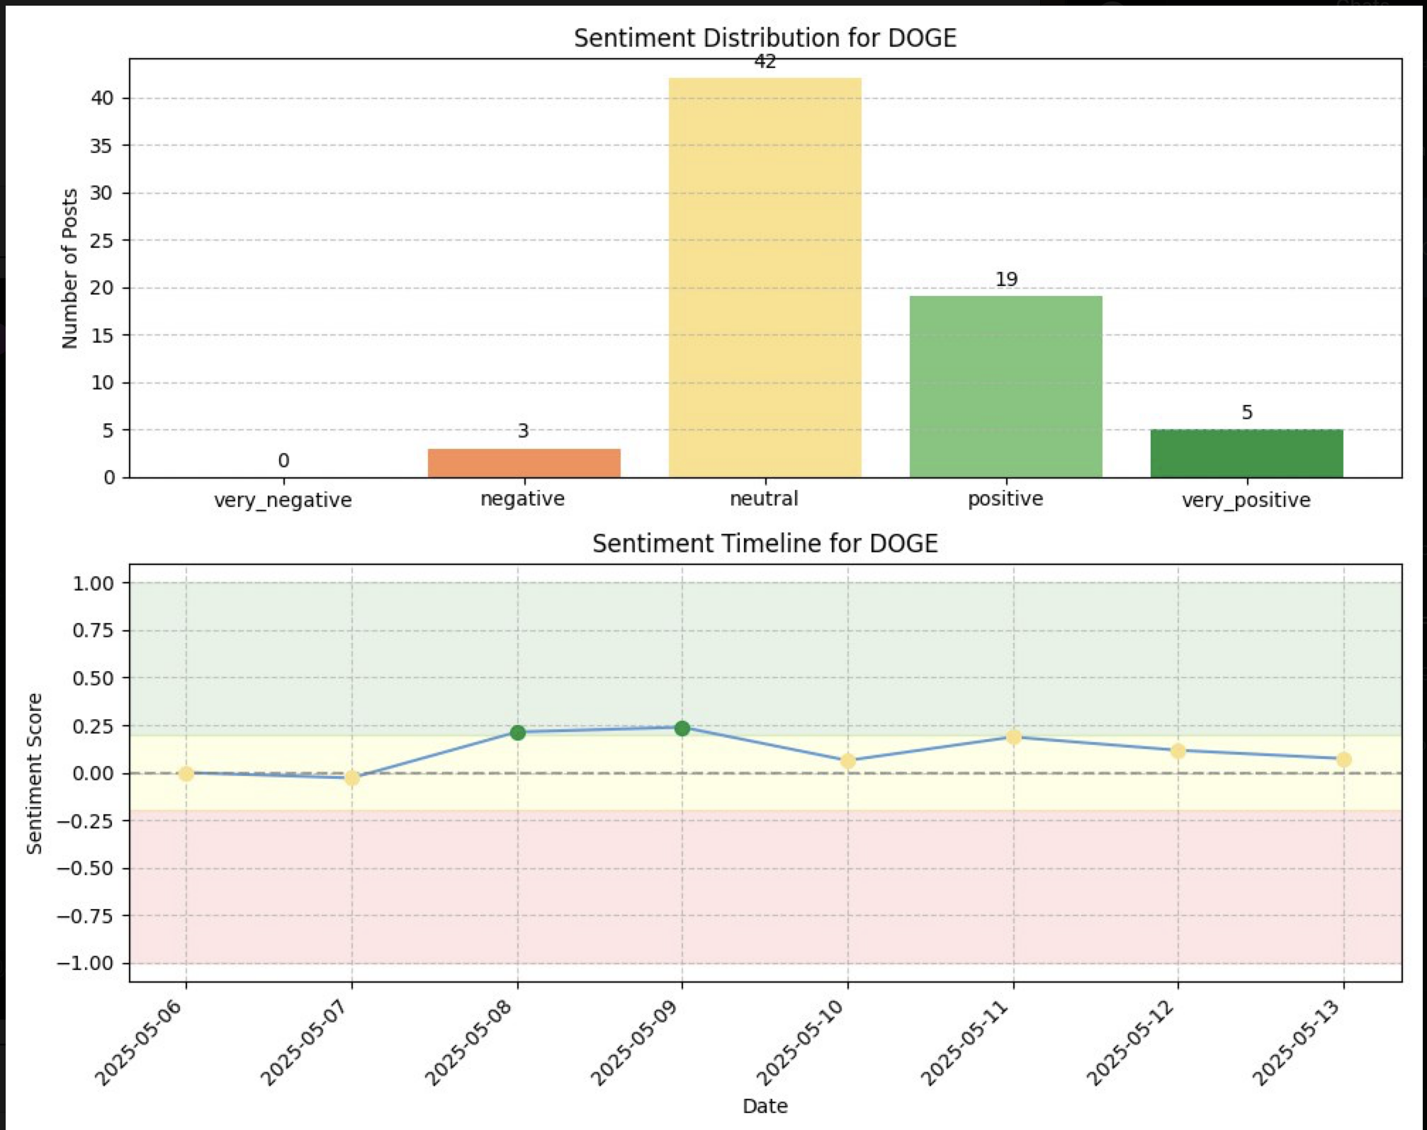
Sentiment Analysis
Sentiment analysis is still valuable as it can help provide insights to oncoming market shift. Therefore, sentiment analysis is integrated into the bot as a buy/sell signal rather than a buy/sell trigger.

Slide 12
Backtesting Strategies
Why these 4 coins?
Test whether the trading bot is able to adapt well to different market conditions
Coin | Role in Ecosystem | Technical Focus | Volatility Profile | Market Type
ETH | Smart contract platform | Decentralized applications | Moderate to high | Trending, Stable and Structured
LINK | Oracle network for smart contracts | Data integration | Moderate | Choppy/Breakout prone
ARB | Ethereum Layer 2 scaling solution | Transaction efficiency | Moderate | Low-volatility / Fast-reversal
DOGE | Peer-to-peer digital currency | Community-driven adoption | High | Sentiment / Volatile

Slide 13
Mapping Market Type to Strategy Design
Backtesting Strategies
What is the mapping based on?
Based on existing literature and market observations
Coin | Market Type | Decided Strategy Design
ETH | Trending / Structured | Works well with momentum, trend-following, and hybrid strategies
LINK | Choppy / Breakout prone | Mean reversion or breakout detection works well
ARB | Low-volatility / Fast-reversal | Needs conservative, volatility-aware, volume-confirmed strategies
DOGE | Sentiment / Volatile | Works well with high reactivity, short-term or sentiment filters
* serves as a guiding principle, not absolute rules

Slide 14
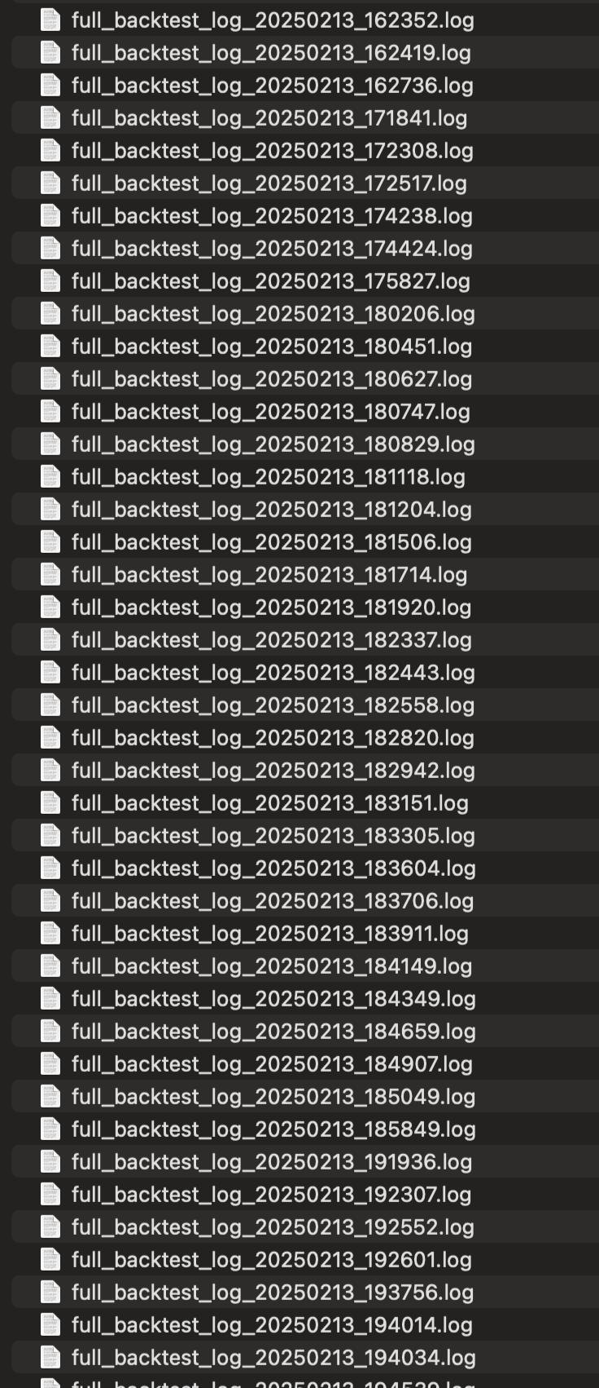
Backtesting Strategies
Backtested over 100 different combinations of strategies and parameters to find most profitable combination
Strategies that consistently performed better…
Coin | Strategy | Why It Works
ETH | Bollinger Band mean-reversion | ETH trends cleanly, reacts well to overextensions
LINK | EMA crossover trend-following | LINK bursts after sideways moves, EMA catches shifts
ARB | Trend pullback with low volatility filter | Filters out noise in ARB's jumpy, thin market
DOGE | Breakout with volume confirmation | DOGE spikes on hype, volume confirms real breakouts

Slide 15
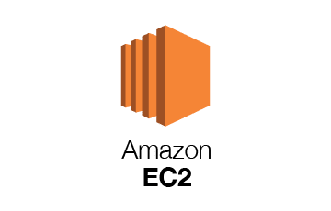

Docker with Cloud Deployment
Runs 24/7 even when laptop is off
Frees up my laptop for backtesting and refinement
Supports scaling, able to deploy multiple bots in parallel
Docker ensures environment are always consistent, anyone can run the bot by pulling from Github and adding their own API keys into the config.yaml

Slide 16
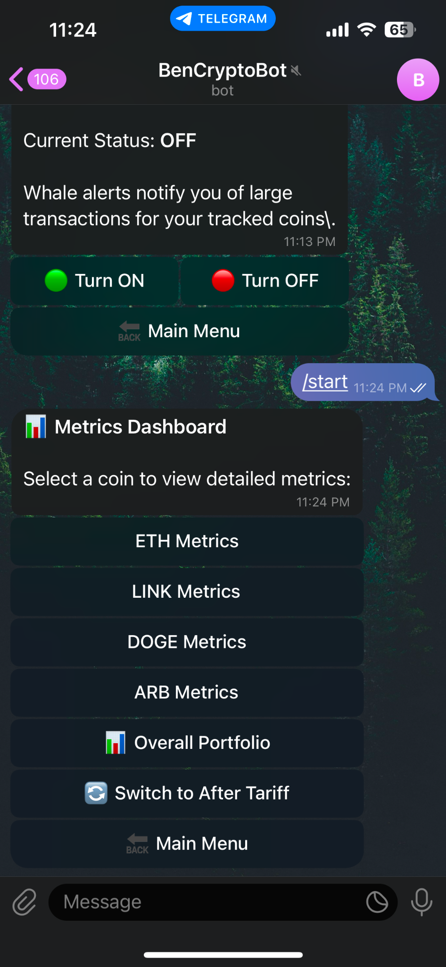
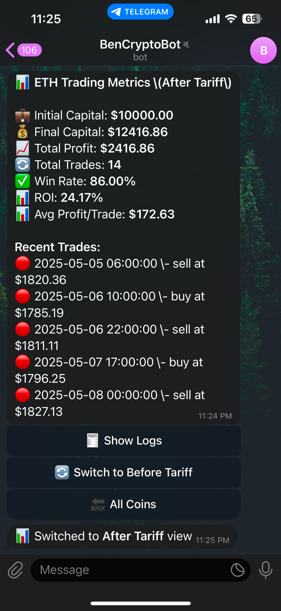
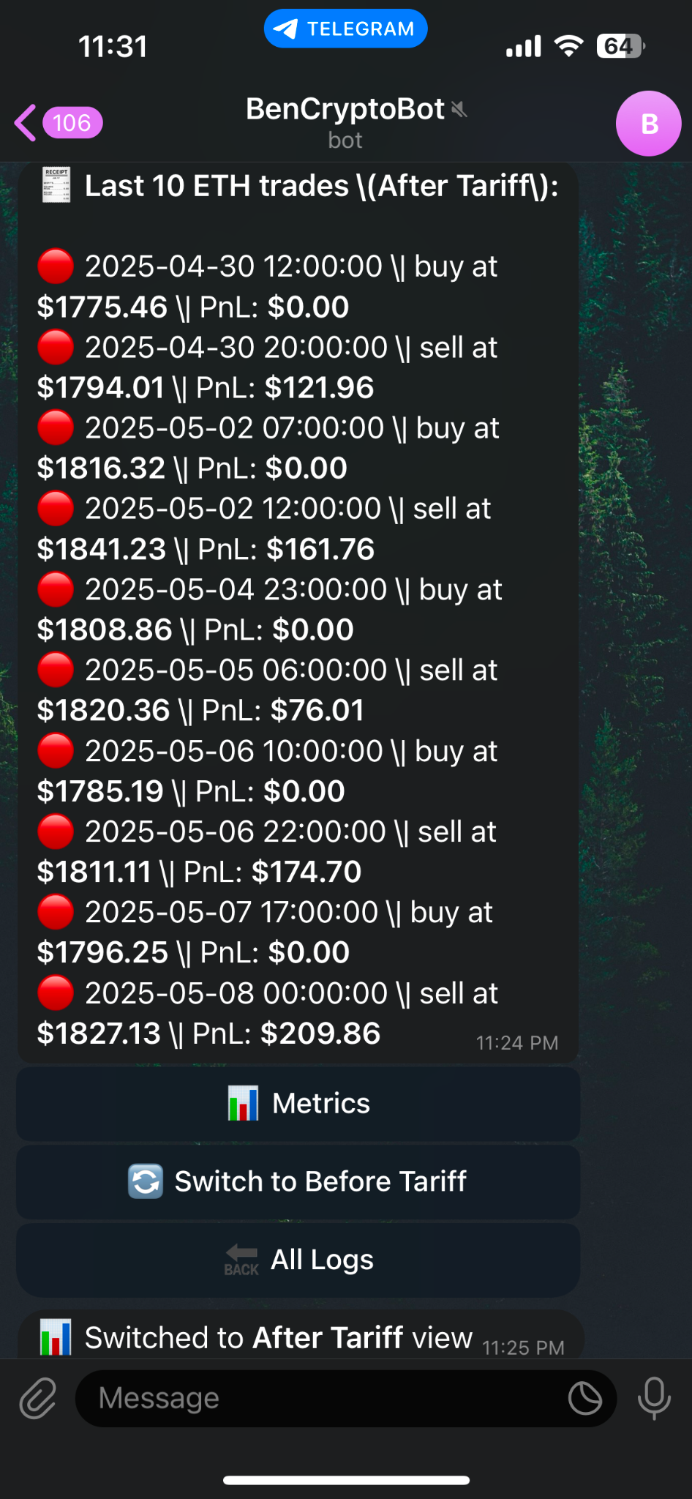
Live Paper Trading Crypto Bot
Individual Metrics Performance Monitor

Slide 17
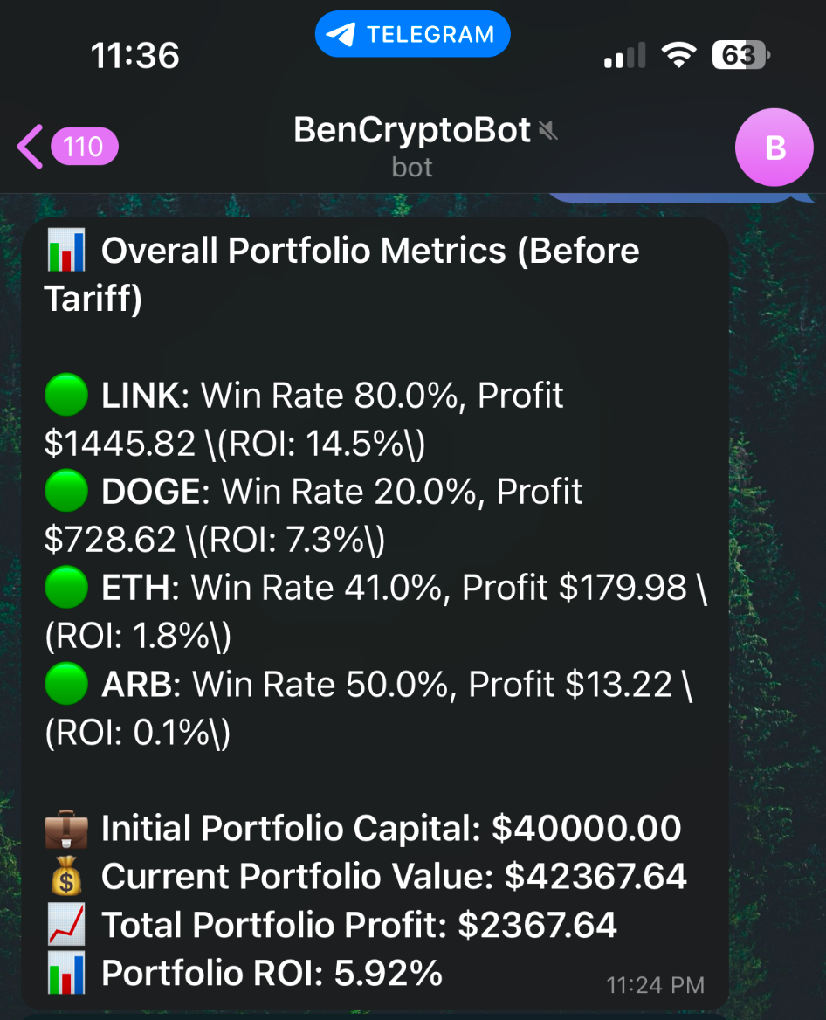
Live Paper Trading Crypto Bot
Overall Portfolio Metrics
As of 1st April
Coin | Profit | Win Rate
ETH | +179.98 | 38.1%
LINK | +1445.82 | 80.0%
ARB | +13.22 | 50.0%
DOGE | +728.62 | 20.0%
✅Total PnL | +2367.64 | Avg Win Rate ~47.0%

Slide 18

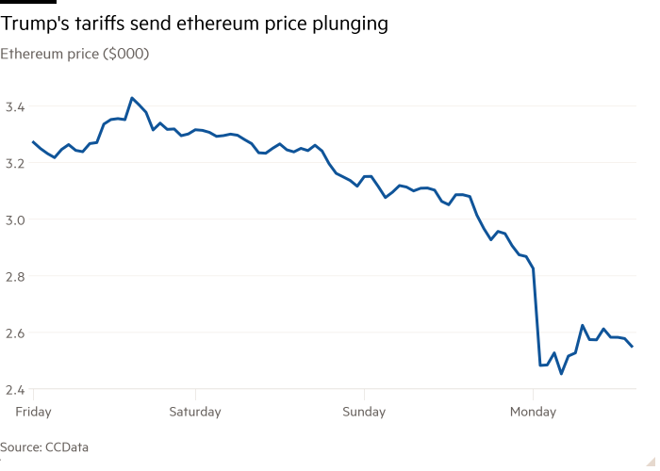
Trump's "Liberation Day" tariffs on April 2, 2025, caused a sharp sell-off in the crypto market, wiping out over $300 billion in market cap within five days. Bitcoin dropped from $86,000 to $74,000, and Ethereum fell from $1,934 to $1,797. Altcoins like Solana and XRP also saw significant declines.
General Performance of the Cryptomarket from 2nd April to 9th April

Slide 19

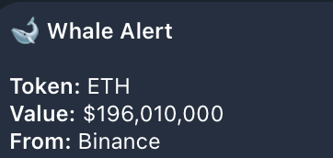
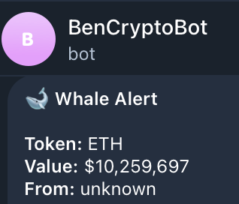
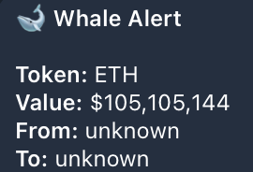
Whale Alerts caught the market shifts early
Multiple Large Transactions were observed

Slide 20
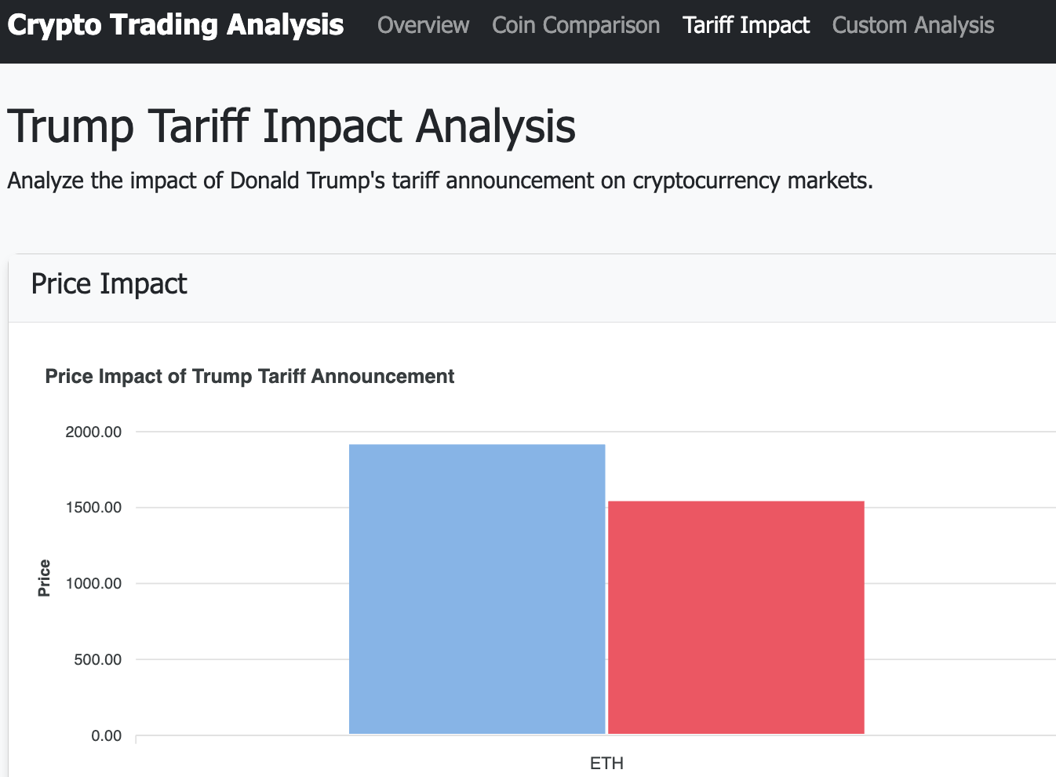
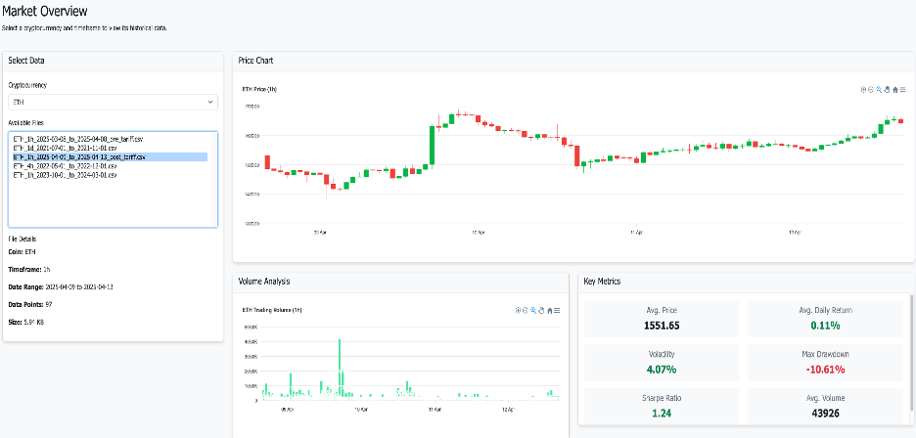
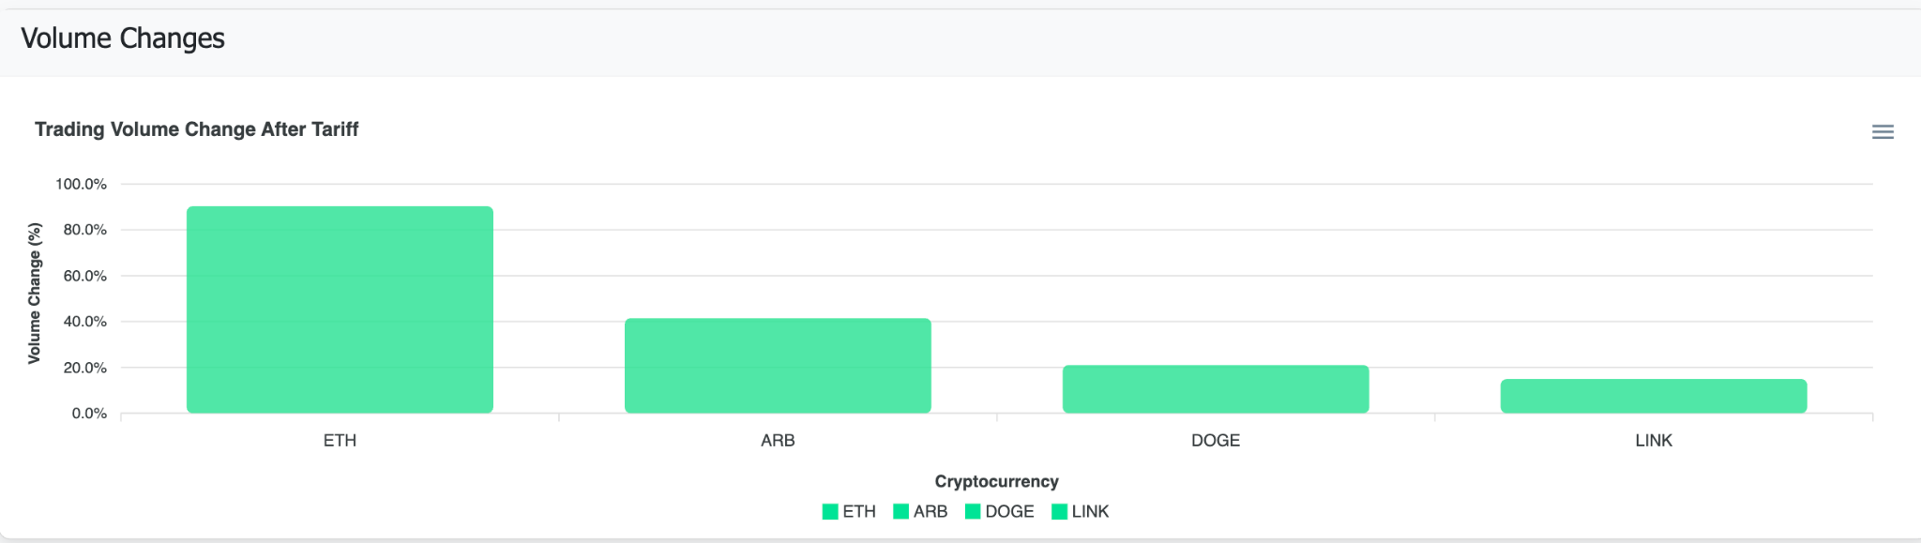
Developed a Webapp to Identify Market Trends and Compare Results

Slide 21
Strategies Adjustment
In Spot Trading, it is unlikely to perform well in a downward trending market, therefore, I adjusted the strategies to be stricter to prevent unnecessary losses
ADX Index
Only trade when trend strength>25, when market is trending and less noise
For ADX<20, ignore most signals to avoid flat/choppy markets.
SMA
SMA 50/200 used for golden/death crosses
SMA 200 bearish filter to block buys and sit out downtrends
Price > SMA 200 bullish filter to allow buy entries only when uptrending
MACD (tells whether buyer or sellers are getting stronger) used to confirm momentum shifts
RSI set stricter thresholds like 30-70 instead of 20-80 to reduce overtrades
Widen bollinger bands, ATR to filter low volatility/noise periods, etc…

Slide 22
On April 9th 2025, Trumps’ following announcement of a 90-day pause on high tariffs for most countries (excluding China), leading to a market rebound. Bitcoin climbed back above $100k by early may and Dogecoin’s price surged by 10%
On May 12th, China was included in the 90 day pause reducing tariffs on China from 145% to 30%
Notes:
Dogecoin (DOGE):
On April 9, 2025, following Trump's announcement of a 90-day pause on higher tariffs for most countries (excluding China), Dogecoin's price surged by 10% .
Earlier, the broader crypto market, including DOGE, experienced declines due to tariff-related uncertainties .Penn Wharton Budget Model+2CoinDesk+2Kiplinger+2

Slide 23
IF STRATEGIES WERE NOT ADJUSTED… RESULTS
Coin | Profit ($) | Win Rate (%)
ETH | -310.96 | 27.8%
LINK | 3,152.24 | 63.6%
ARB | 281.21 | 44.1%
DOGE | 3,878.13 | 29.8%
Total Capital:
$40,000.8
Total Profit:
$6,000.62.8
Total Gain over ~2.5 months:
15.00%.8
Minus 20% from Profit to account for slippage
Adjusted Total Profit:
$4,800.50
Adjusted Total Gain over ~2.5 months:
12.00%

Slide 24
ACTUAL RESULTS
Pre-Tariff (02/28 to 04/02)
Post-Tariff (09/02 to 13/05)
Coin | Profit | Win Rate
ETH | +89.83 | 38.1%
LINK | +1445.82 | 80.0%
ARB | +13.22 | 50.0%
DOGE | +728.62 | 20.0%
✅Total PnL | +2277.49 | Avg Win Rate ~47.0%
Coin | Profit | Win Rate
ETH | +2416.86 | 85.7%
LINK | +2655.51 | 46.2%
ARB | +1536.40 | 62.5%
DOGE | +2704.54 | 35.5%
✅ Total PnL | +9313.31 | Avg Win Rate ~57.5%
Total Capital:
$40,000.8
Total Profit:
$11, 590.8
Total Gain over ~2.5 months:
28.98%.8
Minus 20% from Profit to account for slippage
Adjusted Total Profit:
$9, 270
Adjusted Total Gain over ~2.5 months:
23.18%

Slide 25
LIMITATIONS
Limited to Spot Trading
As a result, during bearish market periods – such as the Trump tariff downward trend 2nd April to 9th April, the system could only cut losses using stop-loss logic, but could not generate profit through short selling
Paper trading only
No real capital is at risk. Execution accuracy does not account for real-world slippage, latency or liquidity issues. Profit and losses are therefore idealized.

Slide 26

FUTURE WORK
Expand into Futures Trading, able to make significant gains even in downward trending markets but it is more risky
Integrate real money trading account via the Binance Spot or Futures API. This will enable testing of slippage and fee impact, psychological robustness of strategies under real capital pressure

Slide 27
CONCLUSION
Developed a multi-strategy crypto trading bot focused on ETH, LINK, DOGE and ARB
Profitable Trading Bot: 23.18% ($9,270) gains in ~2.5 months.
Integrated sentiment signals, technical indicators and whale alerts
Backtested more than 100 combinations of strategies across different market phases.
Deployed bots 24/7 using paper trading on spot markets with real-time monitoring via Telegram bot.

Slide 28

THANK YOU

Slide 29
References
Academic & Theoretical Sources
Aysan, A. F., Caporin, M., & Cepni, O. (2024). Not all words are equal: Sentiment and jumps in the cryptocurrency market. Journal of International Financial Markets, Institutions and Money, 91, 101920. https://doi.org/10.1016/j.intfin.2023.101920
Bouteska, A., Hajek, P., Abedin, M. Z., & Dong, Y. (2023). Effect of Twitter investor engagement on cryptocurrencies during the COVID-19 pandemic. Research in International Business and Finance, 64, 101850. https://doi.org/10.1016/j.ribaf.2022.101850
Chernoff, A., & Jagtiani, J. (2024). Beneath the crypto currents: The hidden effect of crypto “whales” (Working Paper No. 24-14). Federal Reserve Bank of Philadelphia. https://doi.org/10.21799/frbp.wp.2024.14
Cohen, G., & Qadan, M. (2022). The complexity of cryptocurrencies algorithmic trading. Mathematics, 10(12), 2037. https://doi.org/10.3390/math10122037
Detzel, A. L., Liu, H., Strauss, J., Zhou, G., & Zhu, Y. (2021). Learning and predictability via technical analysis: Evidence from bitcoin and stocks with hard-to-value fundamentals. Financial Management, 50(1), 107–137. https://doi.org/10.1111/fima.12310
Financial Stability Board (2022). Assessment of risks to financial stability from crypto-assets. Financial Stability Board. https://www.fsb.org/2022/02/assessment-of-risks-to-financial-stability-from-crypto-assets/​
Herremans, D., & Low, K. W. (2022). Forecasting Bitcoin volatility spikes from whale transactions and CryptoQuant data using synthesizer transformer models (SSRN Working Paper No. 4247685). SSRN. https://doi.org/10.2139/ssrn.4247685
Hudson, R., & Urquhart, A. (2021). Technical trading and cryptocurrencies. Annals of Operations Research, 297(1), 191–220. https://doi.org/10.1007/s10479-019-03357-1
Kulakowski, M., & Frasincar, F. (2023). Sentiment classification of cryptocurrency-related social media posts. IEEE Intelligent Systems, 38(4), 5–9. https://doi.org/10.1109/MIS.2023.3283170
Kyriazis, N., Papadamou, S., Tzeremes, P., & Corbet, S. (2022). The differential influence of social media sentiment on cryptocurrency returns and volatility during COVID-19. The Quarterly Review of Economics and Finance. https://doi.org/10.1016/j.qref.2022.09.004​
Low, J. M., Tan, Z. J., Tang, T. Y., & Salleh, N. (2023). Deep learning and sentiment analysis-based cryptocurrency price prediction. In Proceedings of the 8th International Visual Informatics Conference (IVIC 2023) (pp. 40–51). Springer. https://doi.org/10.1007/978-981-99-7339-2_4
Omole, O., & Enke, D. (2024). Deep learning for Bitcoin price direction prediction: Models and trading strategies empirically compared. Financial Innovation, 10, Article 117. https://doi.org/10.1186/s40854-024-00643-1
Pant, D. R., Neupane, P., Poudel, A., Pokhrel, A., & Lama, B. (2018). Recurrent neural network based Bitcoin price prediction by Twitter sentiment analysis. In 2018 IEEE 3rd International Conference on Computing, Communication and Security (ICCCS) (pp. 128–132). I
EEE. https://doi.org/10.1109/CCCS.2018.8586824​
Roque da Silva, I. R., Hadad Junior, E., & Balbi, P. P. (2022). Cryptocurrencies trading algorithms: A review. Journal of Forecasting, 41(8), 1661–1668. https://doi.org/10.1002/for.2886
Sattarov, O., & Choi, J. (2024). Multi-level deep Q-networks for Bitcoin trading strategies. Scientific Reports, 14, Article 771. https://doi.org/10.1038/s41598-024-51408-w
Sorsen, S., & Schulz, J. (2022). Algorithmic trading and cryptocurrency: A literature review and key findings. In Proceedings of the Midwest Association for Information
Systems Conference (MWAIS 2022) (Paper 5). Association for Information Systems. https://aisel.aisnet.org/mwais2022/5/
Technical Documentation
Binance. (2024). Binance API Documentation. https://binance-docs.github.io/apidocs/
Reddit API. (2024). Reddit Developer Documentation. https://www.reddit.com/dev/api/
Telegram. (2024). Telegram Bot API. https://core.telegram.org/bots/api
Whale Alert. (2024). API Documentation. https://docs.whale-alert.io/

Slide 30
Mapping Market Type to Strategy Design
Backtesting Strategies
What is the mapping based on?
Based on existing literature and market observations
Coin | Typical Behavior | Market Type | Decided Strategy Design
ETH | Mixed but often trendable | Trending / Structured | Works well with momentum, trend-following, and hybrid strategies
LINK | Periods of sideways with bursts | Choppy / Breakout prone | Mean reversion or breakout detection works well
ARB | Still newer, sometimes illiquid | Low-volatility / Fast-reversal | Needs conservative, volatility-aware, volume-confirmed strategies
DOGE | Wild spikes, meme-driven | Sentiment / Volatile | Only works well with high reactivity, short-term or sentiment filters
* serves as a guiding principle, not absolute rules

Slide 31
Strategies Adjustment 2
Indicator | Use Case | Implementations
ADX (Average Directional Index) | Measures trend strength (not direction) | Enter when ADX > 25 and rising — confirms strong trend
MACD | Momentum + trend confirmation | Use MACD cross + histogram expansion as trend confirmation
EMA Crossover (Fast > Slow) | Classic trend signal | Go aggressive when EMA12 > EMA26 with volume support
Volume Surge with Breakout | Confirms strong bullish intent | Combine price breakout with volume spike to avoid fakeouts
Trailing ATR Stop | Dynamic risk management in trending markets | Use 1.5× ATR below entry to ride longer trends safely
RSI with Trend Bias | Momentum + exhaustion filter | Enter on RSI pullback to 45–50 in uptrend, not just oversold

Slide 32
Live Trading Strategy
Coin | Strategy | Why It Works
ETH | Bollinger Band mean-reversion | ETH trends cleanly, reacts well to overextensions
LINK | EMA crossover trend-following | LINK bursts after sideways moves, EMA catches shifts
ARB | Trend pullback with low volatility filter | Filters out noise in ARB's jumpy, thin market
DOGE | Breakout with volume confirmation | DOGE spikes on hype, volume confirms real breakouts

Slide 33
Live Trading Strategy
Coin | What the Bot Looks For | Why It Makes Sense
ETH | Buys when price drops too much, sells when it bounces back | ETH moves steadily, so bounce-backs are common
LINK | Buys when it starts rising, sells when it starts falling | LINK stays flat then jumps, this catches the jump
ARB | Buys during calm dips in an uptrend, sells at small profit/loss | ARB is jumpy, this avoids risky trades
DOGE | Buys only when price jumps with high trading activity | DOGE jumps fast on news, this checks if it's real

Slide 34
Futures trading
Bet on future prices – Agreement to buy/sell a coin at a set price on a future date
Trading based on price movements
Long – Price will go up, win
Short – Price goes down, win
Leverage – Borrow money to increase position, small price changes can lead to big gains (or losses)
If price moves against position a lot, forced to close trade and lose money

Slide 35
Target Users
Crypto traders that:
want to automate their decision-making, whilst giving the flexibility to make strategic changes when required.
detect market shifts early
The system helps them analyze price charts, detect large whale movements and check social media sentiment.
In a way, it is like a 24/7 smart assistant for crypto traders that help to automate trading processes but still allows for flexibility or manual intervention.
Notes:
“My project is built for crypto traders who want to improve their decision-making using data, but don’t have time to monitor the market 24/7. The system helps them by analyzing price charts, detecting large whale movements, and checking social media sentiment. It’s mainly for people who already do manual trading but want some automation and alerts to catch good opportunities faster. Think of it like a smart assistant for crypto traders who don’t want full auto-trading but still want an edge.”

